Slide 1
Azure Cosmos DB, rješenje za globalno distribuirane sisteme
Ratomir Vukadin
Software Engineer

Slide 3
About me
Software engineer
Master student at Faculty of Electrical Engineering
MCP
Summer internship mentor
LinkedIn, GitHub
Blog, coming soon

Slide 4
200 Level

Slide 5
Agenda
Azure Cosmos DB
Cosmos DB model and API projections
Migration to Azure Cosmos DB
DocumentDB SDK
MongoAPI
Demo
WebAPI, Client library, Blog App etc.

Slide 6
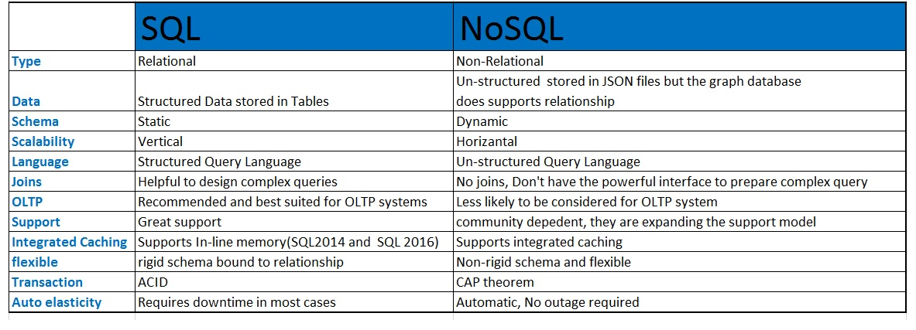
SQL vs NoSQL

Slide 7
Azure Cosmos DB

Slide 8

Azure Cosmos DB
Multi-model database
Model database
Storage across all geographical regions
foundational service

Slide 9
Data engine, multi-model
DB engine, all data translate to ARS (atom-record-sequence)
Atom (A) – Primitive data types like number, string and Boolean.
Record (R) - Structs composed of types stored in Atom.
Sequence (S) - Arrays consisting of atoms, records, or sequences.

Slide 10
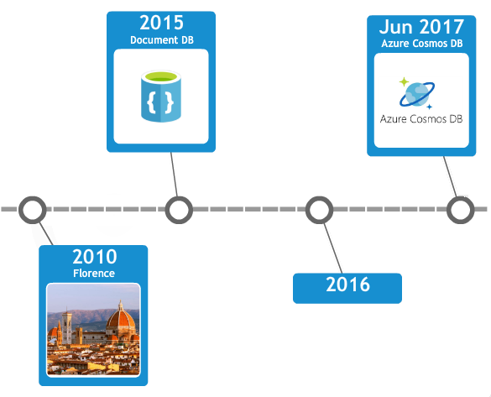

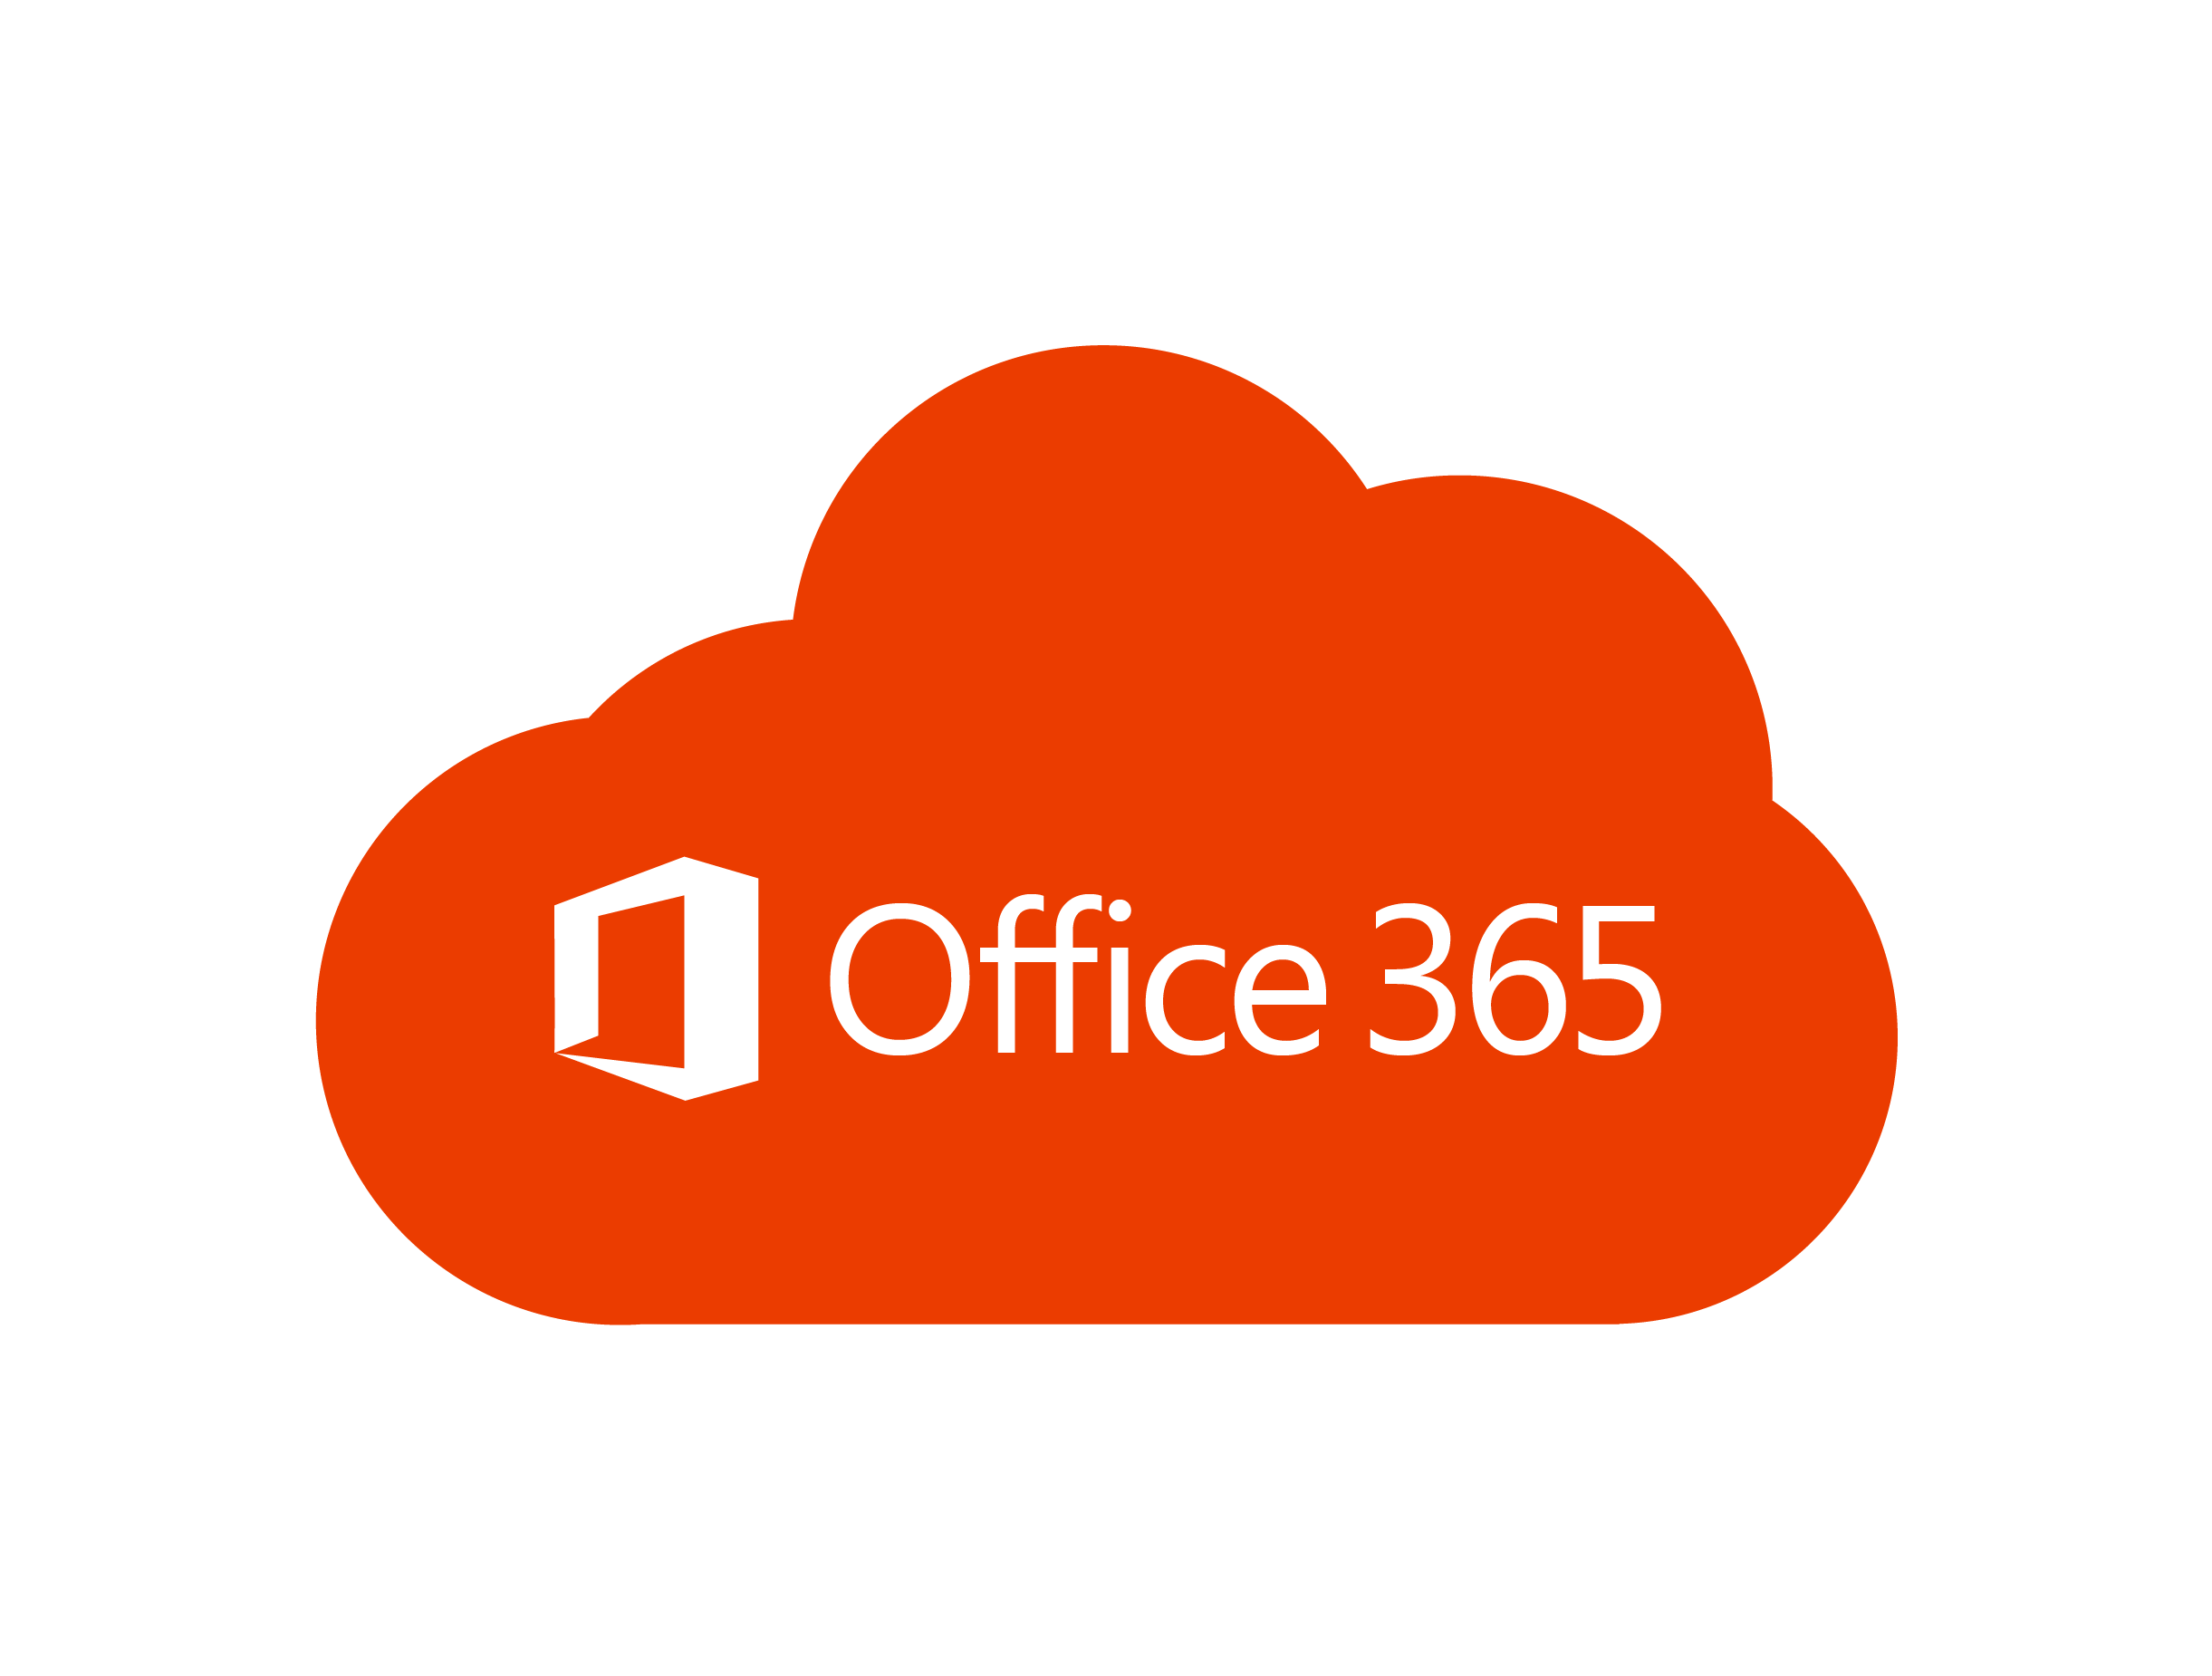

Cosmos DB history

Slide 11
Azure Cosmos DB goals
Data global distribution
Highly responsive systems
Read and write latencies on 99%, 99% reads in < 10ms, writes in < 15ms
The system is “always on”
99.99% availability, end-to-end
Write correct global distributed applications
Relieve the developers from database schema/index, versioning
Keep it in sync
APIs for data, native and popular
A very low cost
Notes:
https://azure.microsoft.com/en-us/blog/a-technical-overview-of-azure-cosmos-db/

Slide 12




Data APIs
Cosmos DB supports multiple APIs

Slide 13
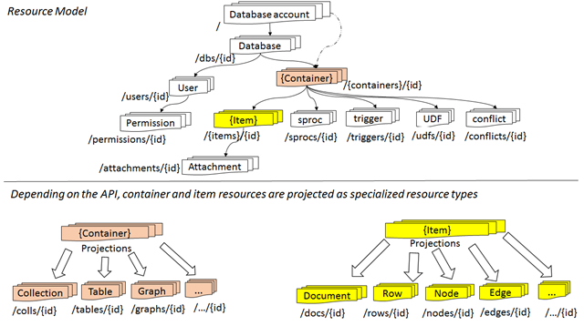
Resource Model Database and API projections
Resource is uniquely identified by URI, represented as JSON document

Slide 14
API, containers, items
API | Container | Item
DocumentDB SQL | Collection | Document
MongoDB | Collection | Document
Azure Table Storage | Table | Item
Gremlin | Graph | Node and Edge

Slide 15



Azure Cosmos DB customers
Toyota
Pizza Dinamo

Slide 16
Quick solution for me
Data caching
Bottleneck
Data analytics

Slide 17
Migration to Azure Cosmos DB

Slide 18
Video

Slide 19
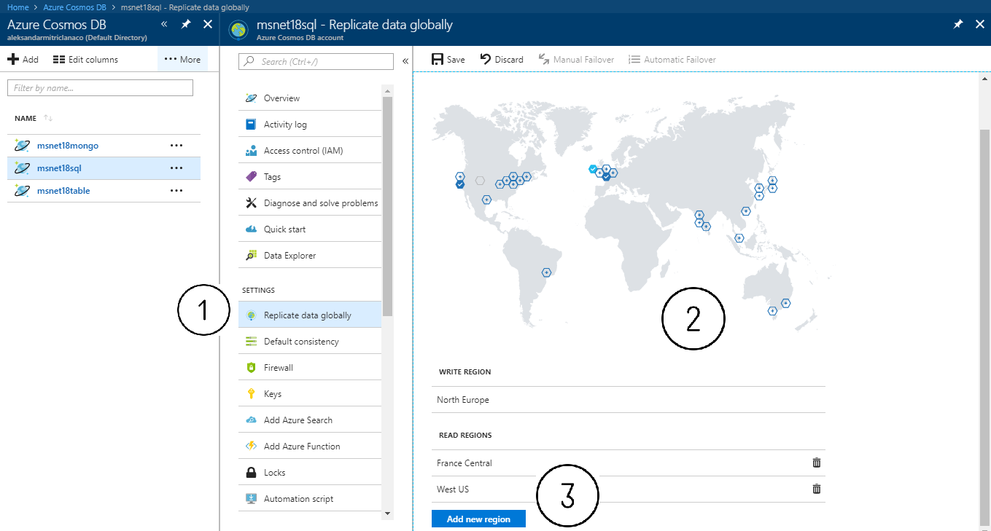
Replicate data globally

Slide 20
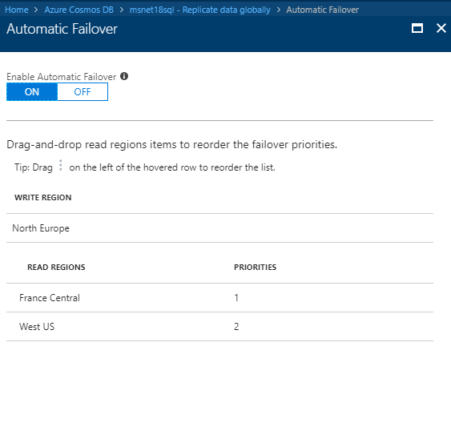
Automatic failover

Slide 21
Demo
Ratomir Vukadin

Slide 22
Quick reference
GitHub repository
https://github.com/Ratomir/MSNETWORK-18
Introduction to Azure Cosmos DB
https://docs.microsoft.com/en-us/azure/cosmos-db/introduction
The most use cases with Azure Cosmos DB
https://docs.microsoft.com/en-us/azure/cosmos-db/use-cases
Technical overview
https://azure.microsoft.com/en-us/blog/a-technical-overview-of-azure-cosmos-db/
YouTube playlist, importing data from MSSQL and JSON data set
https://www.youtube.com/playlist?list=PLHbxRceQ8-1z_zvJ7ldJ5-IEdyw1e3Ea2

